Slide 1


Slide 2
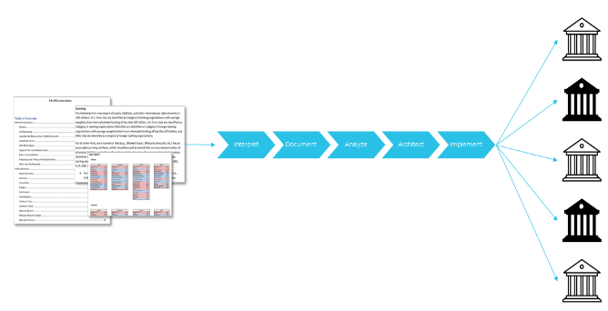
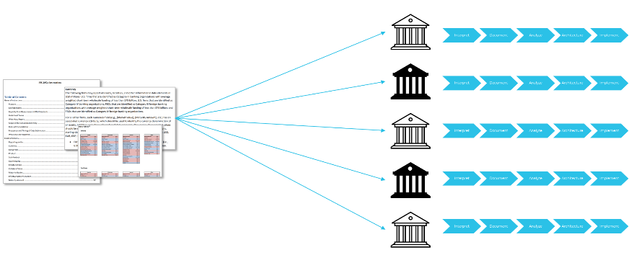
Open Reg Tech
Inefficient
Risky
Efficient
Safe

Slide 3




finos/morphir
Logic as a machine interpretable contract
For Regulation:
Ensure it’s correct
Understand the whole regulation
Future proof
Collaborate across industry, vendors, and regulators
Interpret
Document
Analyze
Implement
3

Slide 4
Pillars of Open Reg Tech
Correctness
Collaboration
Agility

Slide 5
US Liquidity Coverage Ratio (LCR)
Why
Wide audience
Well documented
Perfect size
Non-competitive
What
Categorize
Aggregate
Calculate
2052a Instructions

Slide 6
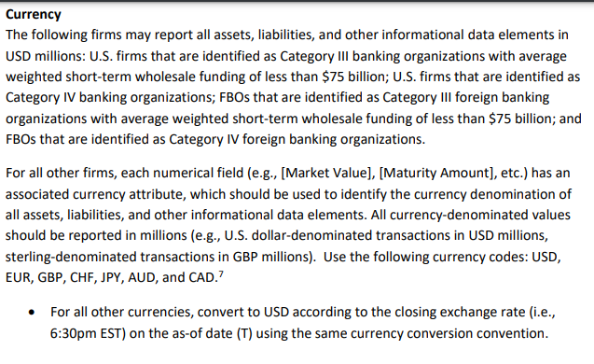
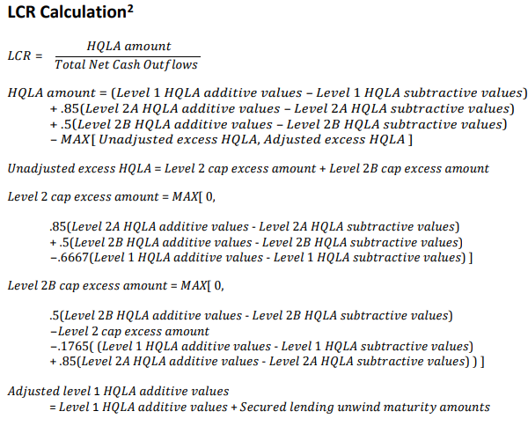
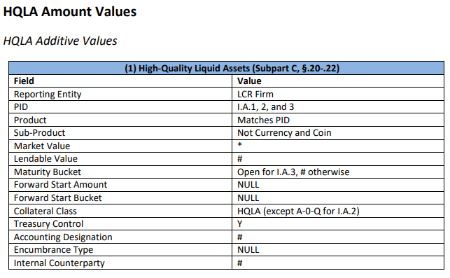
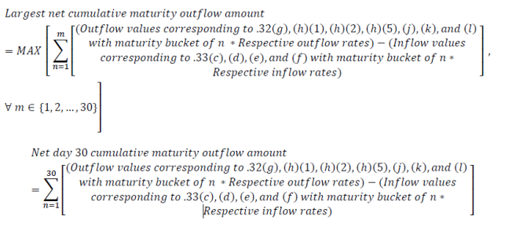
LCR Samples

Slide 7
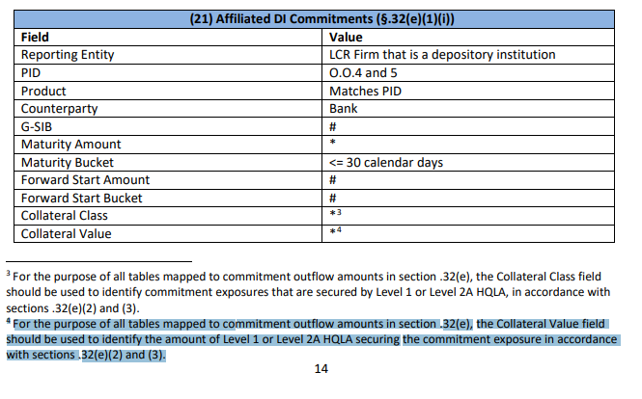
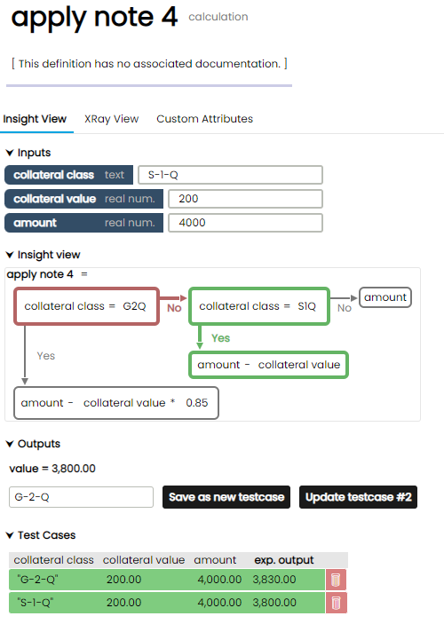
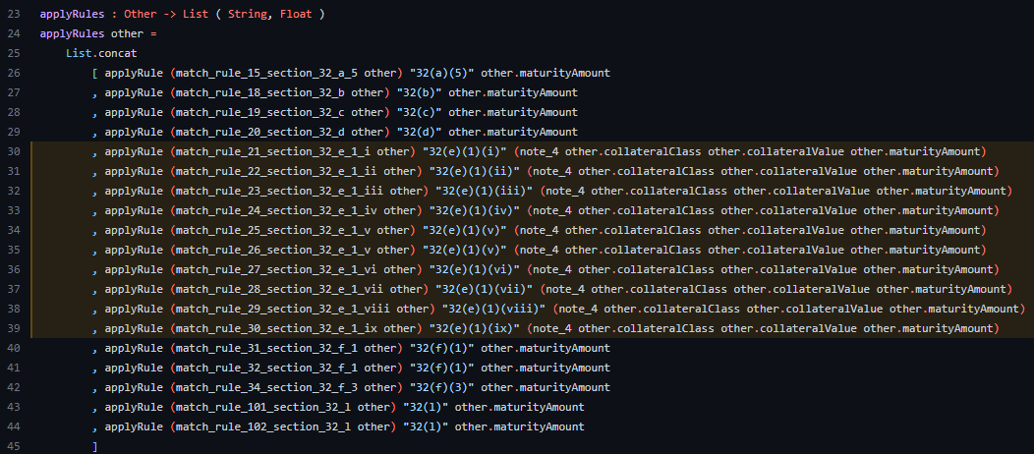
Note 4

Slide 8
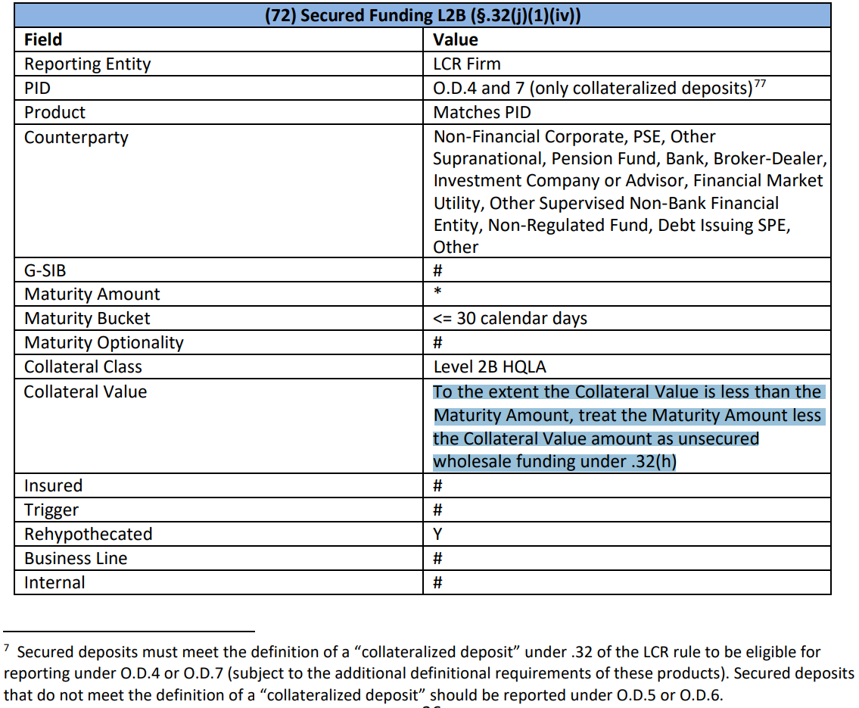
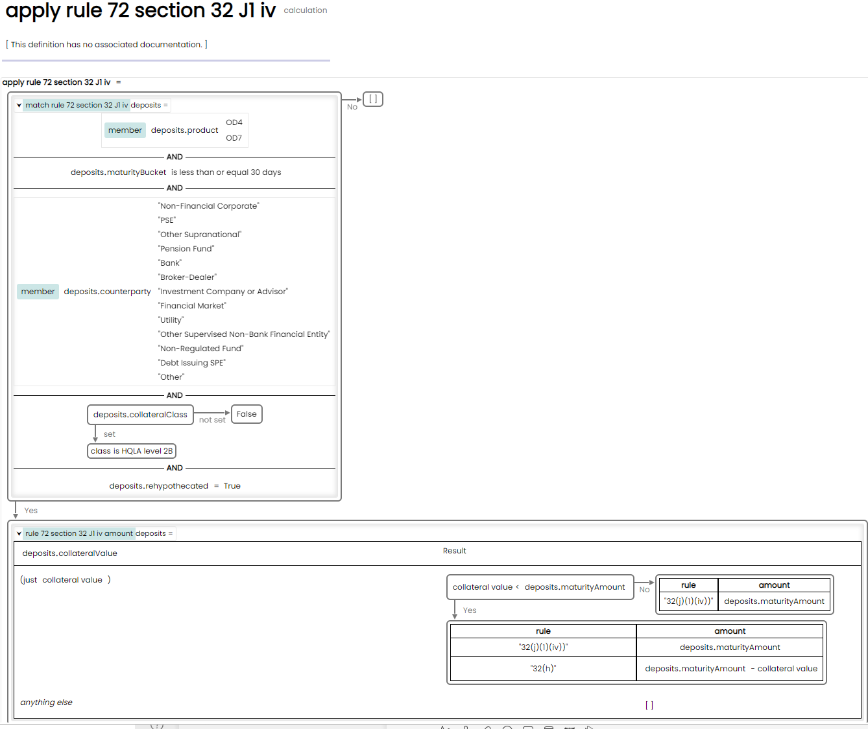
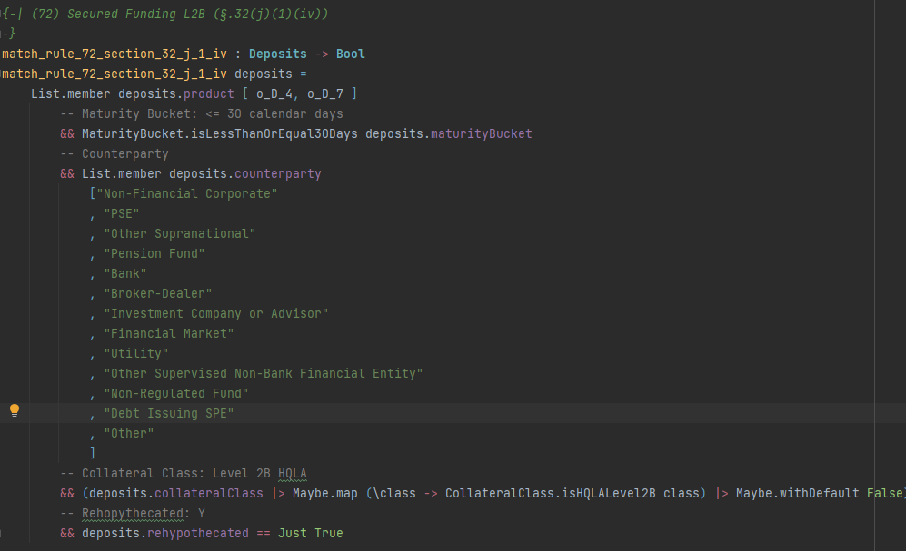
Deposits Rule 72
Notes:
Deposits: Line 170

Slide 9

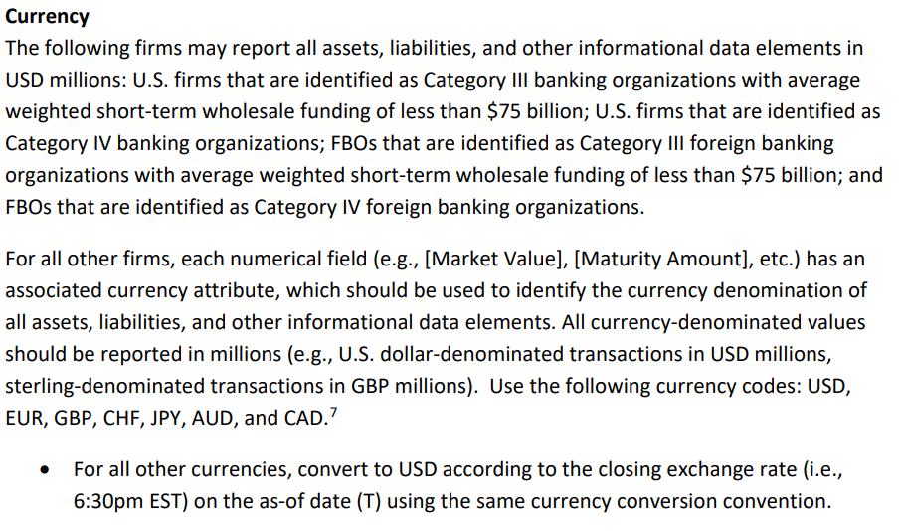
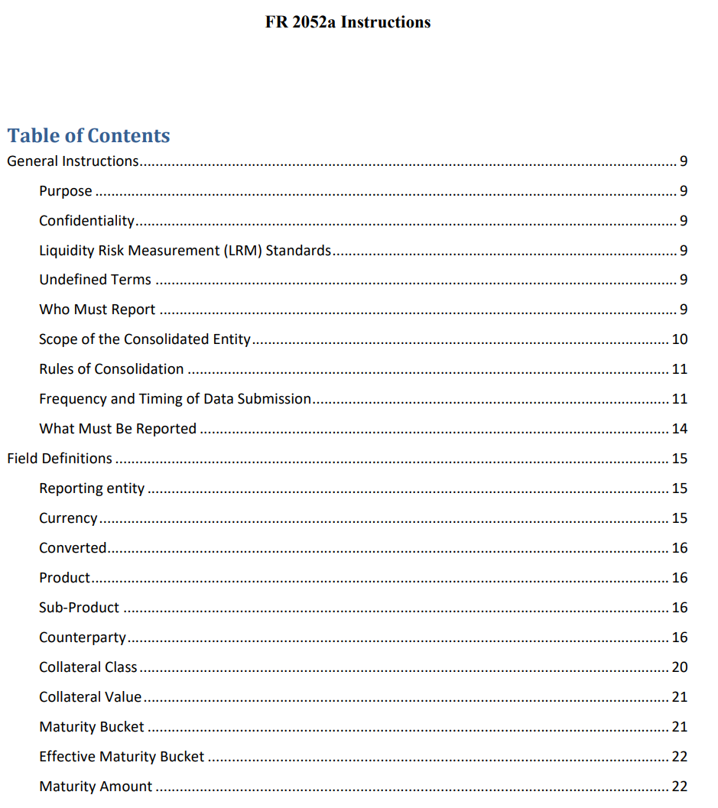

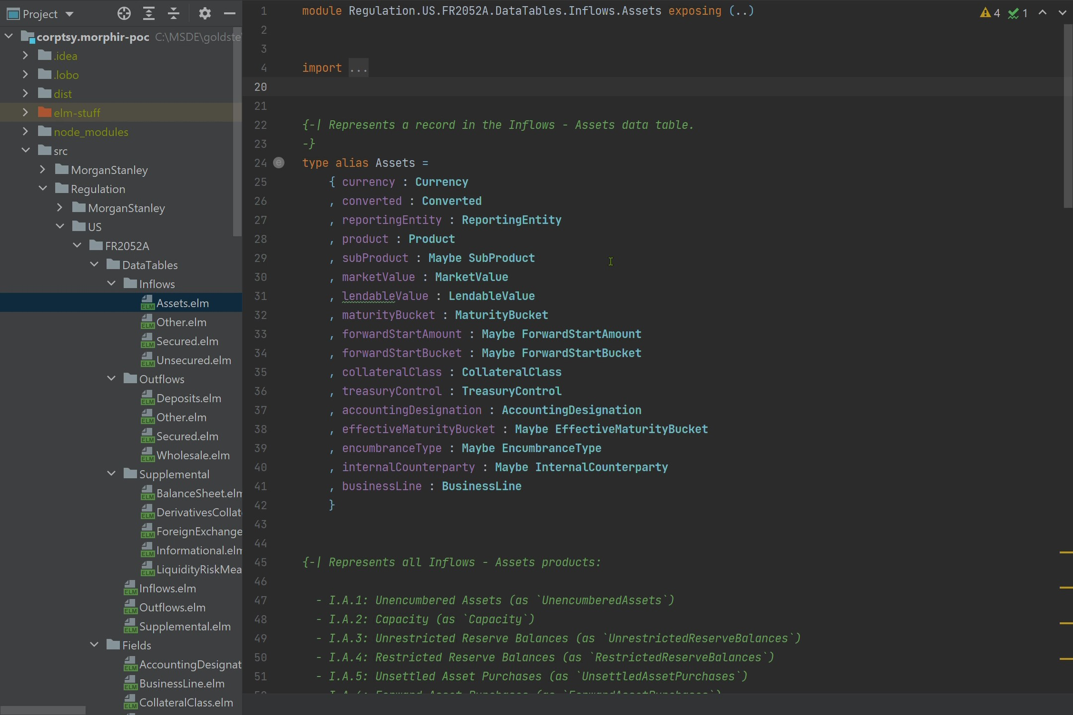
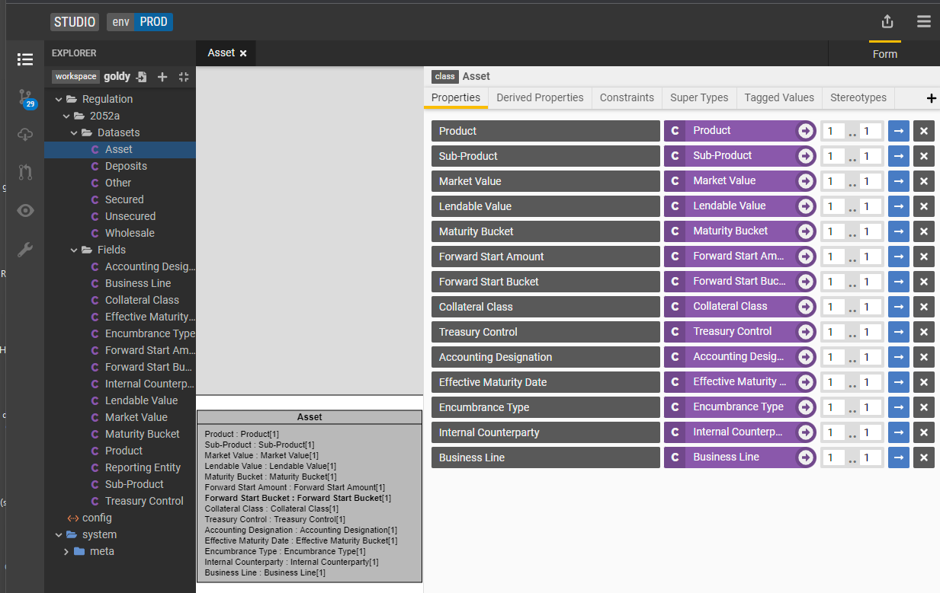
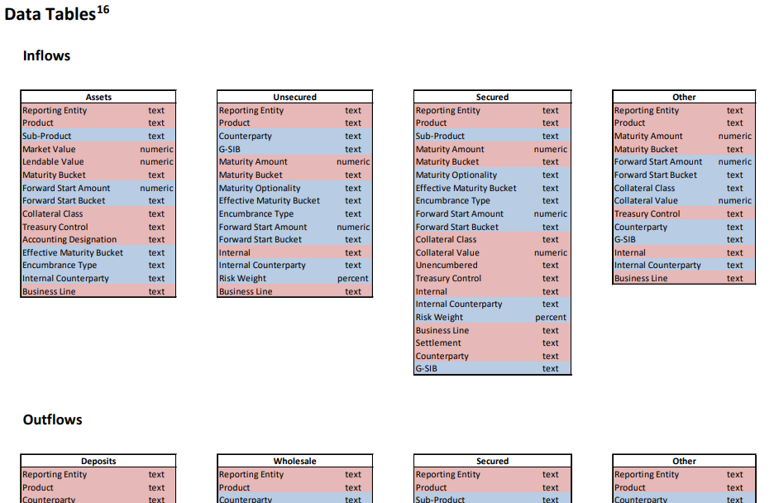

Holistic platform with FINOS ecosystem

Slide 10


Agility
What
Categorize
Aggregate
Calculate

Slide 11
Utilizing the FINOS Ecosystem
Goal: Foundation for open-source delivery and execution that is inclusive of current and future technologies.
Coding the LCR (Morphir)
Holistic
Adaptable
Transparent
Integrated
Verifying Correctness (Bosque)
Ensure correctness
Executing (Spark)
Performant
Scalable
Cloud ready
Integrating firm data (Legend)
Flexible
Fully catalogued and documented

Slide 12
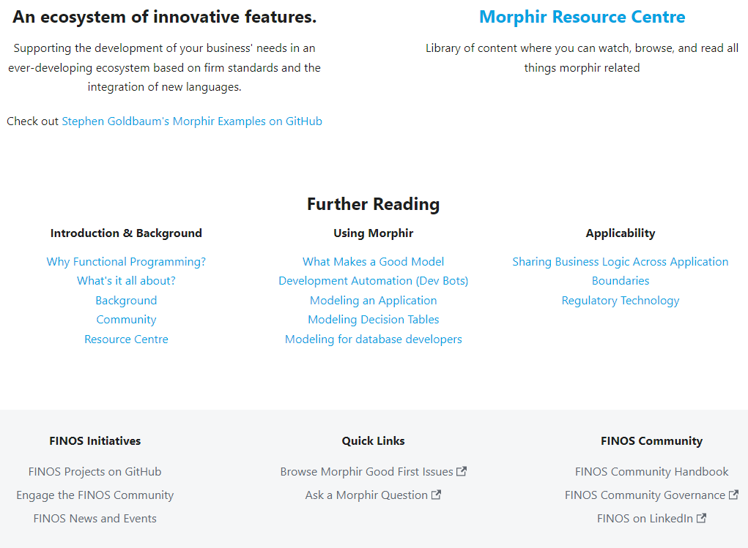
Open-source Success
Incredible partnerships
Incredible potential
Roadmap
Execution
Spark
Microservice
Creation
Scala and more…
Quality
More insight
More Bosque verifier
Integration
Data Management & Data Quality
Ontologies & semantic
Get Involved
Your creativity

